Slide 1
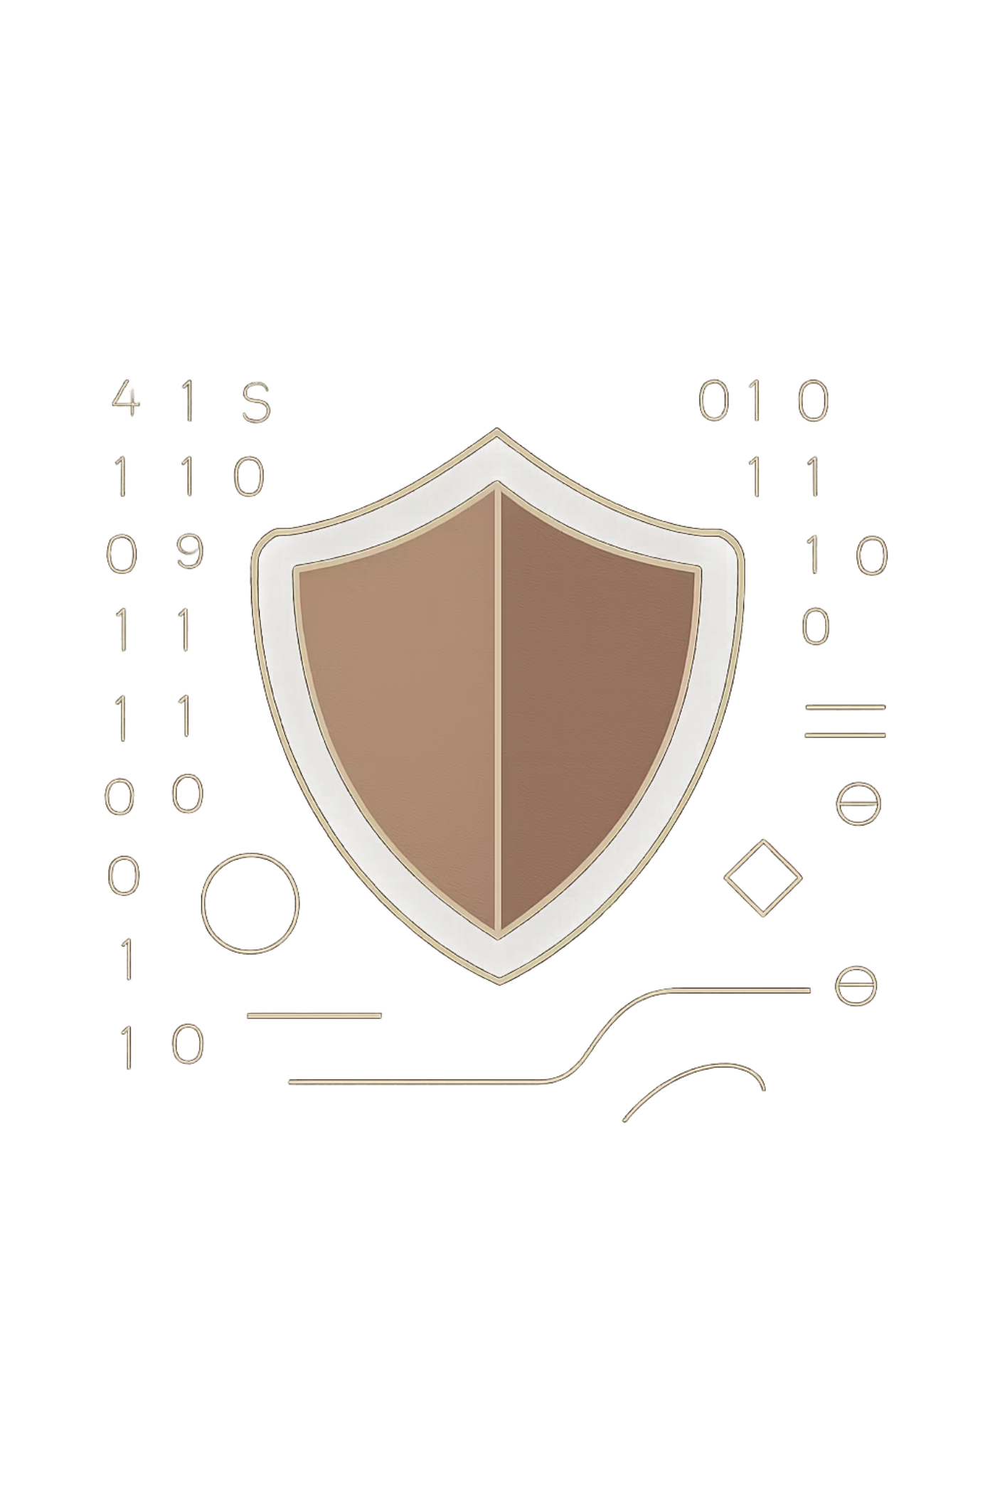
Cybersecurity Laws
A comprehensive guide to the legal frameworks protecting our digital world — from individual privacy to national infrastructure, from corporate accountability to emerging global standards.
CYBERSECURITY LAW
COMPLIANCE & GOVERNANCE
DIGITAL POLICY

Slide 2
The Hidden War: Why Law Matters
Cybercrime is no longer the domain of lone hackers in dark rooms — it is a global, organized threat with devastating real-world consequences. Without a robust legal framework, the digital world would be a lawless frontier.
$10.5T
39s
60%
Annual Cybercrime Cost
Attack Frequency
Small Business Impact
Projected global damages by 2025, making cybercrime more costly than most national economies
A cyberattack occurs somewhere in the world every 39 seconds, on average
Of small businesses close within six months of a significant cyberattack
Law serves as the critical firewall between digital order and anarchy — defining what is permissible, establishing consequences, and creating the accountability structures that make the internet safe for commerce, communication, and civic life.

Slide 3

The Foundation: Computer Fraud and Abuse Act (CFAA)
Enacted 1984
Evolution Through the Patriot Act
The CFAA is the cornerstone of U.S. federal cybersecurity legislation — the original "anti-hacking" statute that established criminal liability for unauthorized computer access.
The CFAA was significantly expanded following the September 11 attacks. The USA PATRIOT Act broadened its scope to address terrorism-related cyber threats, enhanced surveillance capabilities, and increased penalties for repeat offenders.
Key amendments also addressed modern attack vectors including denial-of-service attacks, malware distribution, and credential theft — making the CFAA a living statute that adapts to the evolving threat landscape.
Prohibits unauthorized access to "protected computers"
Covers both external intrusions and insider threats
Applies to any computer used in interstate commerce
The CFAA remains controversial — critics argue its broad language can criminalize routine security research and terms-of-service violations.

Slide 4
Privacy as a Right: The GDPR Standard
The General Data Protection Regulation (GDPR), enacted in 2018, redefined data privacy on a global scale. It established that personal data belongs to the individual — not the corporation — and set a new worldwide benchmark for data protection law.
Mandatory Breach Notification
Strict Consent Requirements
Organizations must report qualifying data breaches to supervisory authorities within 72 hours of discovery, and to affected individuals when risk is high.
Data processing requires explicit, informed, and freely given consent. Pre-checked boxes and vague privacy policies no longer meet the legal standard.
Severe Financial Penalties
Individual Rights
Violations can result in fines of up to 4% of annual global turnover or €20 million — whichever is greater. Companies like Amazon and Meta have faced billion-dollar penalties.
GDPR grants individuals the right to access, correct, delete, and port their data — fundamentally shifting power from organizations back to people.

Slide 5

Corporate Accountability: Sarbanes-Oxley (SOX)
The Catalyst: Corporate Fraud Crisis
The Cost of Non-Compliance
Passed in 2002 in response to the Enron and WorldCom scandals, the Sarbanes-Oxley Act fundamentally changed how publicly traded companies manage and report financial information. Section 404 is the cybersecurity-relevant core — it mandates that management assess and auditors verify the effectiveness of internal controls over financial reporting.
In practice, this means IT departments are now essential auditors. Any system that touches financial data — from ERP platforms to email servers — falls under SOX scrutiny.
Criminal penalties of up to 20 years for executives who certify false reports
Fines reaching $5 million for individuals and $25 million for organizations
Delisting from stock exchanges and permanent reputational damage
Destroyed shareholder trust — often the most costly consequence
SOX compliance is not a one-time event. It requires continuous monitoring, documentation, and annual recertification.

Slide 6

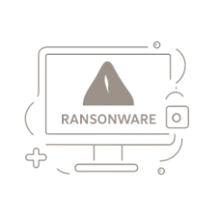

Industry-Specific Shields: HIPAA & Beyond
Not all data is created equal. Certain industries handle information so sensitive that sector-specific legislation was required to ensure adequate protection. Healthcare leads this category.
HIPAA (1996)
Why Industry Standards Matter
The Human Cost
The Health Insurance Portability and Accountability Act protects the sanctity of personal health information (PHI). Its Security Rule mandates administrative, physical, and technical safeguards for electronic PHI. Violations can result in fines up to $1.5 million per year per violation category.
Data exposure in healthcare doesn't just mean financial loss — it can mean denied insurance, damaged reputations, and life-altering consequences for patients whose most private information becomes public.
Healthcare is the #1 target for ransomware attacks. Industry-specific standards like HIPAA create a baseline security posture that makes organizations harder targets. Compliance frameworks also provide a defensible legal position when incidents occur.

Slide 7
The Cloud Dilemma: Who Owns the Data?
When organizations migrate to the cloud, they hand over physical control of their data to third-party vendors — creating a complex legal landscape around ownership, liability, and access rights.
The Stored Communications Act (SCA)
The Vulnerability Gap
Part of the Electronic Communications Privacy Act (1986), the SCA governs how third-party providers like AWS, Google, and Microsoft handle stored user data. It defines when and how the government can compel disclosure — and what protections users retain.
Key limitation: The SCA was written before cloud computing existed, leaving significant gray areas in modern application.
When servers move outside your security perimeter, your legal obligations don't disappear — they multiply. Organizations remain liable for data breaches even when the vulnerability originates with a cloud provider.
Legal Vetting Priorities
Data residency and cross-border transfer clauses
Breach notification timelines and responsibilities
Audit rights and compliance certifications (SOC 2, ISO 27001)
Liability caps and indemnification provisions

Slide 8

The New Horizon: EU's NIS2, DORA, and CRA
Europe is once again leading global cybersecurity regulation. A new wave of legislation enacted between 2022–2024 is raising the bar for critical infrastructure, financial services, and product security design.
NIS2 Directive
DORA Regulation
Cyber Resilience Act (CRA)
Expands cybersecurity obligations to thousands more entities across energy, transport, healthcare, and digital infrastructure. Introduces strict incident reporting deadlines and personal liability for senior management non-compliance.
The Digital Operational Resilience Act (2025) requires financial institutions and their ICT third-party providers to withstand, respond to, and recover from ICT-related disruptions. Cloud providers serving finance face direct supervision.
Moves security requirements into product design. Manufacturers of hardware and software with digital elements must meet cybersecurity requirements before placing products on the EU market — security by design, not by patch.
By 2025, compliance with these frameworks will be a competitive advantage — organizations that lead on compliance will win enterprise contracts and consumer trust.

Slide 9

Civil vs. Criminal: The Two-Pronged Sword
Cybersecurity incidents can trigger two distinct legal pathways simultaneously. Understanding the difference is essential for organizations responding to a breach or defending against allegations.
⚖️ Civil Law
🔒 Criminal Law
Civil actions are brought by private parties — individuals, companies, or regulators — seeking remedies for harm suffered.
Criminal prosecution is brought by the state against individuals or entities accused of violating cybersecurity statutes.
Damages: Monetary compensation for losses
Injunctions: Court orders to stop harmful conduct
Settlements: Negotiated resolutions without trial
Class Actions: Aggregated claims from many affected parties
Prosecution: Led by government agencies (DOJ, FBI, etc.)
Penalties: Fines, probation, and imprisonment
Forfeiture: Seizure of equipment and illicit gains
Extradition: International pursuit of suspects
Standard of proof: Preponderance of evidence (more likely than not)
Standard of proof: Beyond a reasonable doubt
A single incident — like a data breach — can trigger both civil lawsuits from affected customers and criminal investigation by federal authorities.

Slide 10
Conclusion: Compliance Is Your Competitive Edge
Cybersecurity law is not a regulatory hurdle to clear — it is the blueprint for building lasting business trust in the digital age. Organizations that treat compliance as a strategic priority consistently outperform those that treat it as a checkbox exercise.
Shift from Reactive to Proactive
Audit Your Data Landscape
Know Your Regulations
Don't wait for a breach to understand your obligations. Build a legal-technical strategy that anticipates regulatory changes and embeds compliance into your operations from the start.
Know what data you hold, where it lives, who has access, and which regulations apply. Data mapping is the foundation of every effective compliance program.
Whether you're subject to CFAA, GDPR, HIPAA, SOX, or the new EU frameworks — ignorance is not a defense. Invest in legal counsel and compliance training as core business infrastructure.
"The question for companies is not whether they will be attacked — it's whether they'll be ready when it happens. Legal preparedness is the first line of defense."

